Slide 1
Question Answering

Slide 2
Introduction
Question Answering(QA) is application of NLP where response to a question is automated in natural language.

Slide 3
Knowledge based
Information Retrieval based
Neural based

Slide 4
Types
Reading comprehensions
Closed-domains
Open-domains

Slide 5
Libraries
huggingface/transformers
facebookresearch/ParlAI
PaddlePaddle/ERNIE
dmlc/gluon-nlp

Slide 6
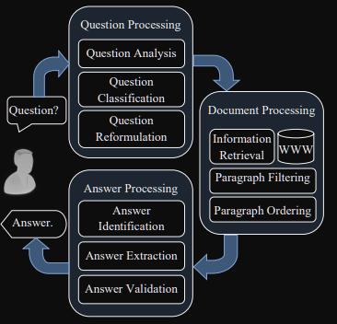
QA system
https://www.section.io/engineering-education/question-answering/

Slide 7
Applications
Business
Education
Data Analytics

Slide 8
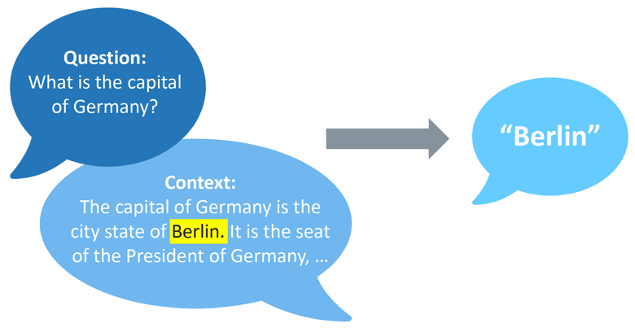
Example
https://blog.seeburger.com/natural-language-question-answering-systems-get-quick-answers-to-concrete-questions/

Slide 9
Dataset
Quora
StackExchange
Stanford Question Answering Dataset(SQUAD)

Slide 10


